Slide 1

Fraud detection in financial transactions using machine learning algorithms
Suleimenova Inkara

Slide 2

Introduction
Fraud detection in financial transactions has grown increasingly critical as the volume and complexity of digital transactions continue to expand. This digital evolution introduces new vulnerabilities and sophisticated methods of fraud that financial institutions must address. The stakes are high—fraudulent activities can result in significant financial losses, reputational harm, and severe security breaches. The primary objective of this project is to design a robust framework for detecting fraudulent transactions using advanced machine learning algorithms, enabling the identification of suspicious activities in real time and reducing false positives.

Slide 3

The Role of Machine Learning Algorithms
The manipulation of machine learning data plays a key role in understanding the intricate patterns and the hidden correlations of fraudulent activities. The use of machine learning algorithms in fraud detection and prevention contributes to making more accurate inferences about potential threats. It also helps businesses to react proactively to these threats by learning from historical fraud patterns.

Slide 4
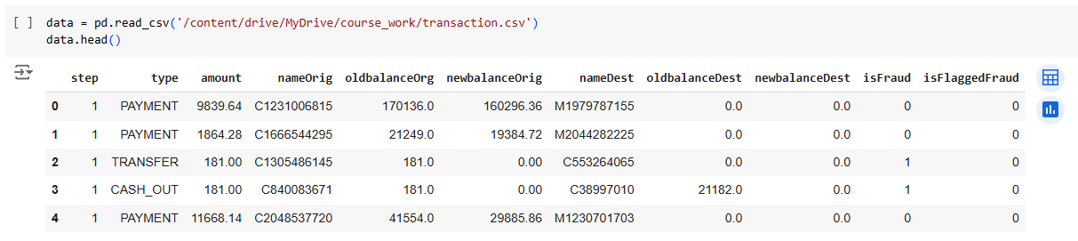
Dataset and Preprocessing
The dataset used in this project is the "Synthetic Financial Datasets for Fraud Detection" available on Kaggle. It simulates mobile money transactions and incorporates malicious behaviors for testing fraud detection methods.

Slide 5
Name of the variable | Description
step | maps a unit of time in the real world. In this case 1 step is 1 hour of time. Total steps 744 (30 days simulation).
type | CASH-IN, CASH-OUT, DEBIT, PAYMENT and TRANSFER.
amount | amount of transaction in local currency.
nameOrig | customer who started the transaction.
oldbalanceOrg | initial balance before the transaction.
newbalanceOrig | new balance after the transaction.
nameDest | customer who is the recipient of the transaction.
oldbalanceDest | initial balance recipient before the transaction. Note that there is not information for customers that start with M (Merchants).
newbalanceDest | new balance recipient after the transaction. Note that there is not information for customers that start with M (Merchants).
isFraud | This is the transactions made by the fraudulent agents inside the simulation. In this specific dataset the fraudulent behavior of the agents aims to profit by taking control or customers accounts and try to empty the funds by transferring to another account and then cashing out of the system.
isFlaggedFraud | The business model aims to control massive transfers from one account to another and flags illegal attempts. An illegal attempt in this dataset is an attempt to transfer more than 200.000 in a single transaction.
Data Description

Slide 6
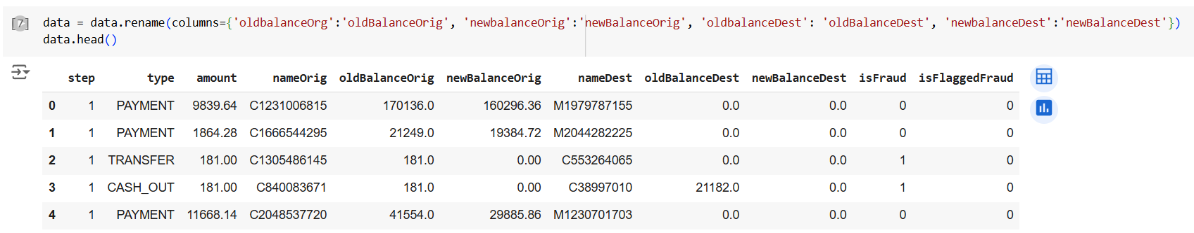
The result of renaming
Data preprocessing was then initiated. Some column names were incorrect, so they were renamed using the .rename method for consistency and clarity.

Slide 7
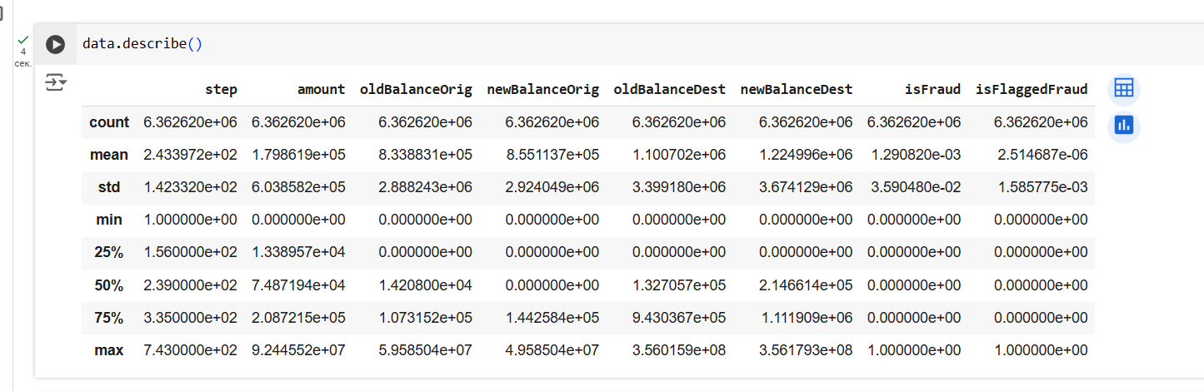
Before analysis, it is critical to examine the summary statistics of the dataset’s numeric variables. Key metrics like the mean, standard deviation, and the range of values at different percentiles provide insights into their distribution. Below is a brief explanation of the metrics:
Count: The total number of non-missing entries for a variable.
Mean: The average value of a variable, calculated by summing all entries and dividing by their count.
Standard Deviation (std): Reflects the variability of the data points around the mean. A larger value indicates more significant variation.
Min: The smallest value observed in the dataset for the variable.
25% (First Quartile): The value below which 25% of the data points lie.
50% (Median): The midpoint value, with 50% of data points above and below it.
75% (Third Quartile): The value below which 75% of the data points lie.
Max: The largest value observed in the dataset.
Describe the data.

Slide 8
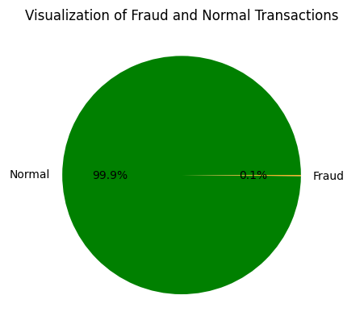
Visualization of Fraud and Normal Transaction.
The dataset shows a significant class imbalance, with fraudulent transactions accounting for only 0.13% of the total (8,213 instances). This imbalance is critical as it implies that non-fraudulent transactions dominate the data. If a machine learning model is trained on such skewed data, it could disproportionately focus on normal transactions, potentially leading to biased results. Addressing this imbalance is essential to build a robust model capable of accurately detecting fraud.

Slide 9
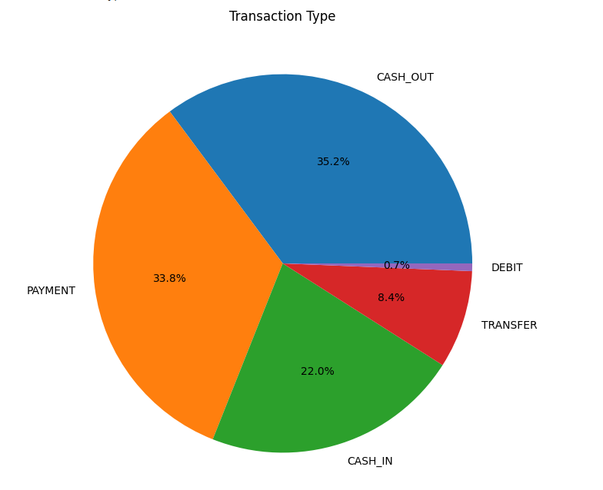
Transaction Type
The most frequent transaction types in the dataset are as follows:
CASH-OUT: 35.2%
PAYMENT: 33.8%

Slide 10
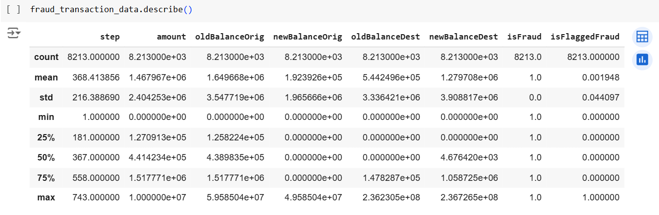
Describe the fraud transaction type.
Two specific flags in the dataset are of particular interest:
isFraud: This column indicates actual fraudulent transactions in the dataset.
isFlaggedFraud: This column shows transactions flagged by the system as potentially fraudulent due to triggered thresholds.
To analyze these in detail, the data is split into normal and fraudulent transactions, followed by detailed exploration of each type.

Slide 11
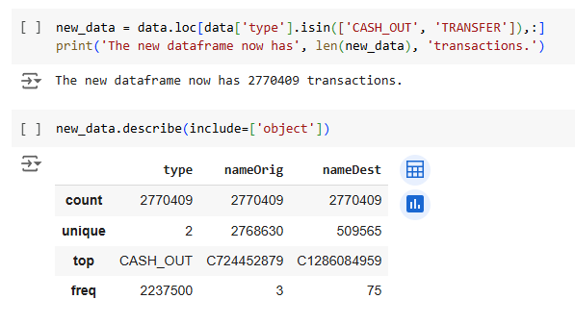
Describe transaction data
The original dataset was reduced from over 6 million transactions to approximately 2.8 million transactions for easier analysis.

Slide 12
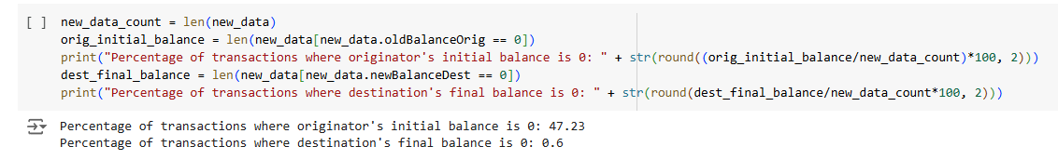
Therefore, in almost half of the transactions, the originator's initial balance was recored as 0. However, in less than 1% of cases, the recipient's final balance was recored as 0.
Ideally, the recipient's final balance should be equal to the reipient's initial balance plus the transaction amount. Similarly, the originator's final balance s hould be equal to originator's initial balance minus the transaction amount.
Precentage of transactions

Slide 13
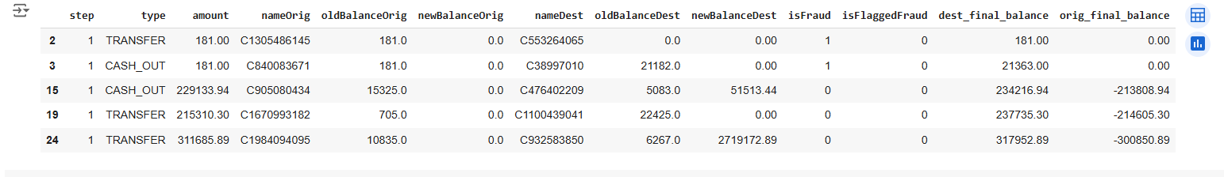
The transaction amount (amount) was highly skewed, which could negatively affect model performance. To address this, two transformations were applied:
Square Root Transformation: Reduces skewness by dampening larger values.
Box-Cox Transformation: A more sophisticated method to normalize data.
Three histograms illustrate the impact of these transformations:
The original data distribution is shown in blue, with a high positive skew.
Transformed distributions are shown in red, demonstrating reduced skewness.
Skewness values are annotated directly on the graphs to quantify the improvements.
Final balance

Slide 14
The transaction amount (amount) was highly skewed, which could negatively affect model performance. To address this, two transformations were applied:
Square Root Transformation: Reduces skewness by dampening larger values.
Box-Cox Transformation: A more sophisticated method to normalize data.
Three histograms illustrate the impact of these transformations:
The original data distribution is shown in blue, with a high positive skew.
Transformed distributions are shown in red, demonstrating reduced skewness.
Skewness values are annotated directly on the graphs to quantify the improvements.
Final balance

Slide 15
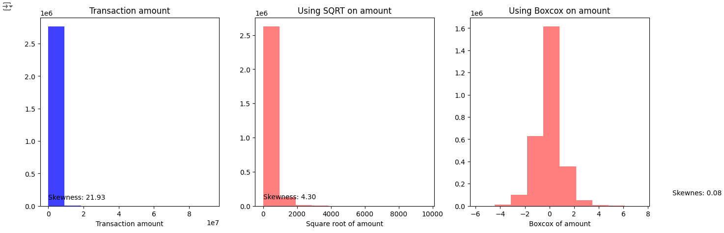
Amount skewness

Slide 16
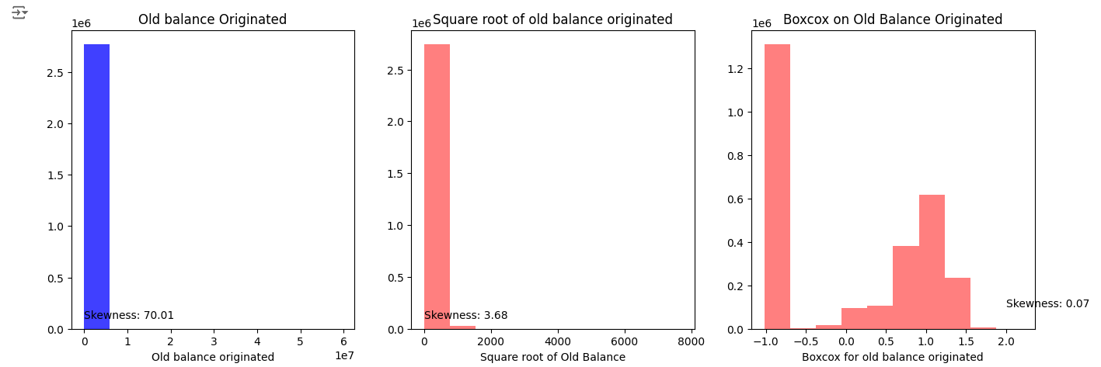
Old balance skewness

Slide 17
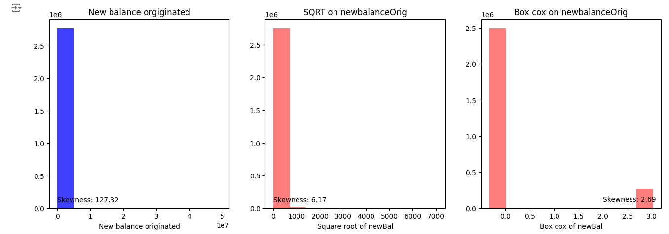
New balance Orig skewness

Slide 18
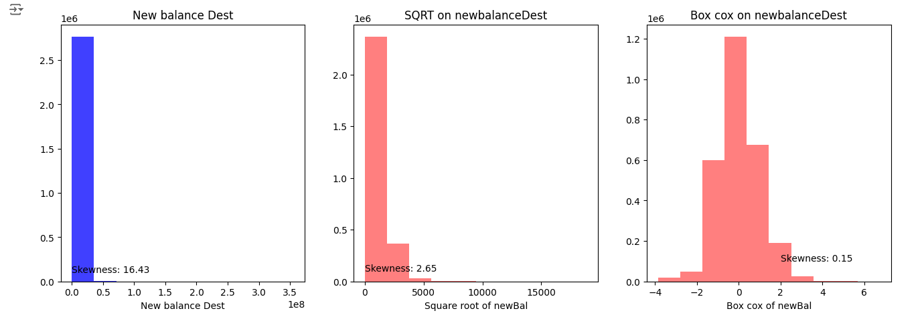
New balance Dest

Slide 19
Balancing datasets
In analyzing the dataset, a major challenge arose: the significant class imbalance between normal and fraudulent transactions. Fraudulent transactions accounted for a very small percentage of the total data, making it crucial to address this imbalance to ensure the machine learning model could accurately detect fraudulent behavior. Ignoring this imbalance could lead to a model heavily biased toward the majority class, resulting in missed fraudulent transactions.
To tackle this problem, three common techniques for balancing datasets were considered:
Undersampling: This approach reduces the size of the majority class by randomly removing samples to balance it with the minority class. While effective in creating balance, it risks losing valuable information from the majority class.
Oversampling: In this method, the minority class is increased by duplicating its samples, thereby improving its representation in the dataset. Although it avoids data loss, oversampling can introduce redundancy and overfitting.
SMOTE (Synthetic Minority Oversampling Technique): A more advanced method that generates synthetic samples for the minority class rather than duplicating existing ones. This helps create diversity in the minority class, making it a robust choice for balancing data.
Given the computational demands of SMOTE and the simplicity of undersampling, the latter was chosen. The undersampled training dataset included all fraudulent transactions and an equal number of randomly selected normal transactions, ensuring a balanced dataset without overburdening computational resources.

Slide 20
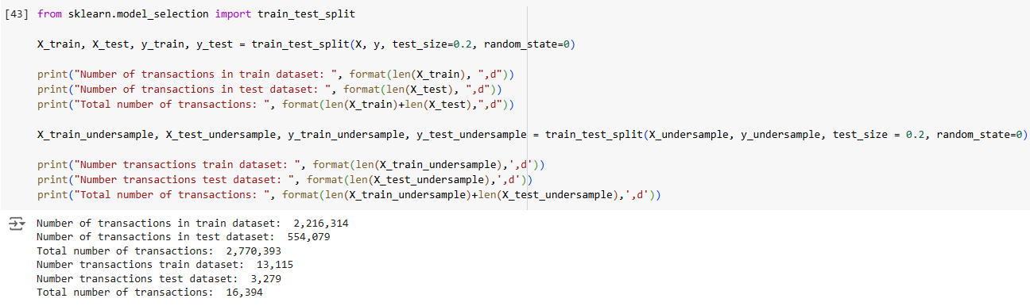
The dataset was divided into training and testing subsets to train the model and evaluate its performance effectively:
Training Data: Consisted of 80% of the original dataset, used to train the model.
Testing Data: Comprised the remaining 20%, reserved for evaluating the model’s predictions.
The undersampled dataset underwent a similar split to maintain consistency, ensuring an equal number of fraudulent and normal transactions for training purposes.
Train_test_split

Slide 21

Introduction to Logistic Regression
Logistic regression is a machine learning algorithm used for binary classification. It predicts the probability of a categorical outcome (e.g., yes/no, survive/didn't survive). For example, predicting if a Titanic passenger survived based on features like age, gender, etc. A logistic regression model was selected for its simplicity, computational efficiency, and ability to produce interpretable results.

Slide 22
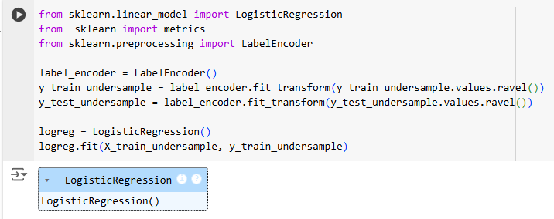
Logistic Regression

Slide 23
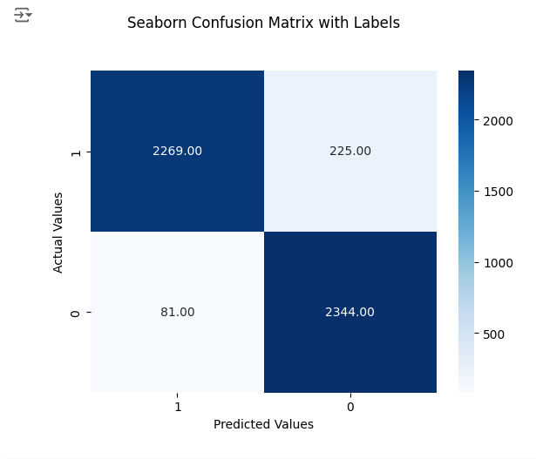
Seaborn Confusion Matrix with Labels
The plot above represents the Receiver Operating Characteristic (ROC) curve for a logistic regression model used to detect fraudulent transactions. This curve provides a graphical evaluation of the model's ability to distinguish between classes—in this case, fraudulent and non-fraudulent transactions.
Key Points:
True Positive Rate (TPR) (y-axis): Also known as recall or sensitivity, it measures the proportion of actual fraud cases correctly identified by the model.
False Positive Rate (FPR) (x-axis): This measures the proportion of normal transactions incorrectly classified as fraudulent.
The ROC curve shows the trade-off between the true positive rate and the false positive rate at various classification thresholds. The red dashed line represents a baseline model with no predictive power (random guessing). Any model above this line performs better than random classification.

Slide 24
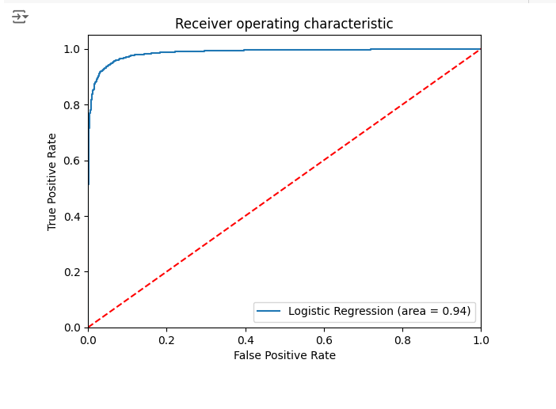
Receiver operating characteristic
Logistic regression is a statistical and machine learning algorithm used for binary classification tasks. It models the probability of a target variable yyy belonging to a specific class (e.g., fraudulent vs. legitimate transactions) based on one or more input features XXX. The foundation of logistic regression lies in the logit function and the sigmoid function, which maps real-valued inputs to probabilities in the range [0,1][0, 1][0,1].
Insights from the Plot:
The ROC curve for the logistic regression model is significantly closer to the top-left corner of the plot, indicating strong performance.
The Area Under the Curve (AUC) score, which quantifies the overall performance of the model, is 0.94. This score indicates a high level of accuracy, as a perfect model would have an AUC of 1.0, while a random model would score 0.5.

Slide 25
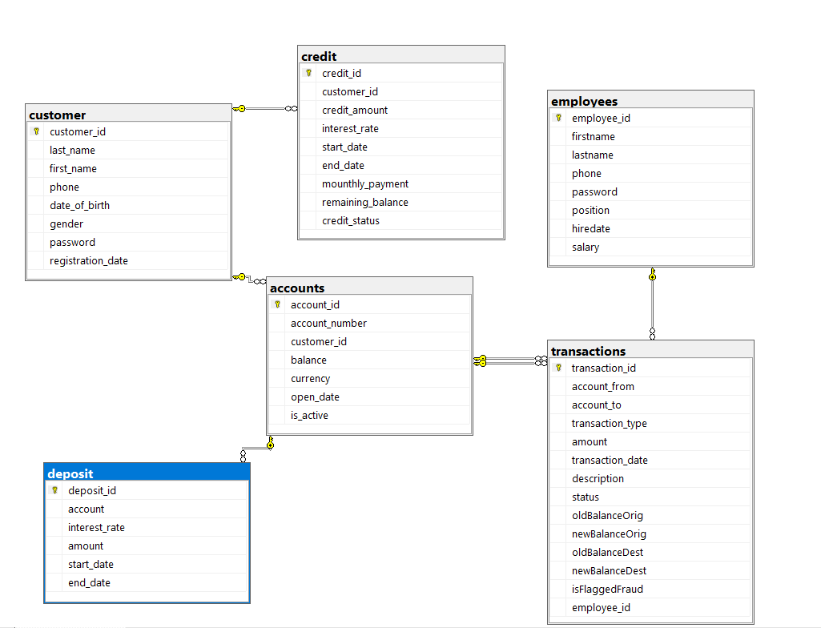
UML
The first focus is the creation of the database for the banking application. A database is a structured collection of data that is stored and accessed electronically. It is crucial for managing the data associated with a banking application, including customer accounts, transactions, and employee details. The chosen development environment for this task was SQL Server Management Studio 19 (SSMS), a comprehensive tool for managing SQL Server databases.

Slide 26
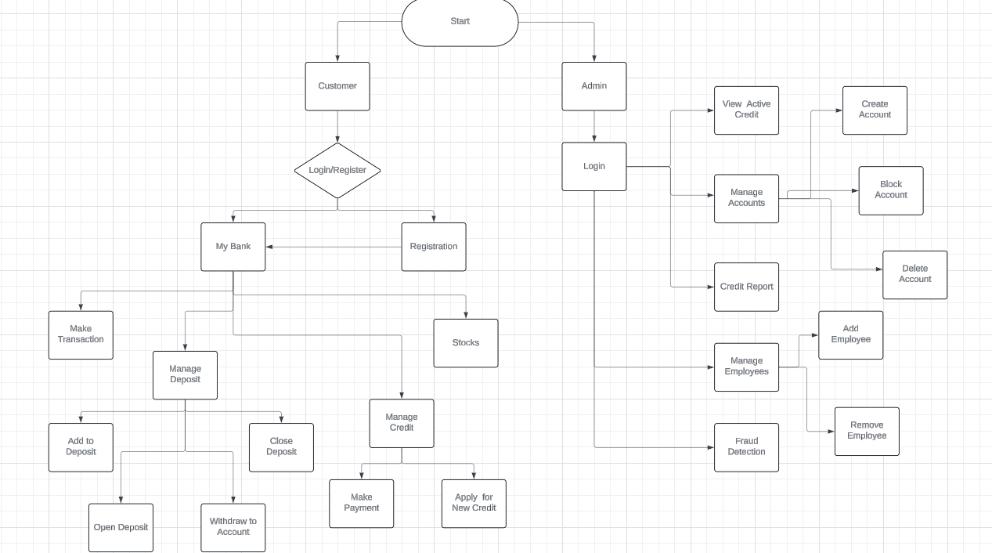
Flowchart
A flowchart is a graphical representation of a process or workflow using standardized symbols, such as rectangles, diamonds, and arrows. It illustrates the sequence of operations or steps required to accomplish a task, making it easier to identify inefficiencies, errors, or redundancies in a process. Flowcharts are especially valuable in programming for outlining the logic of algorithms and ensuring that each step is clearly defined before coding begins.

Slide 27
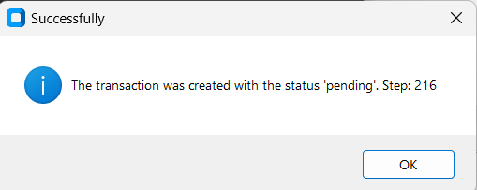
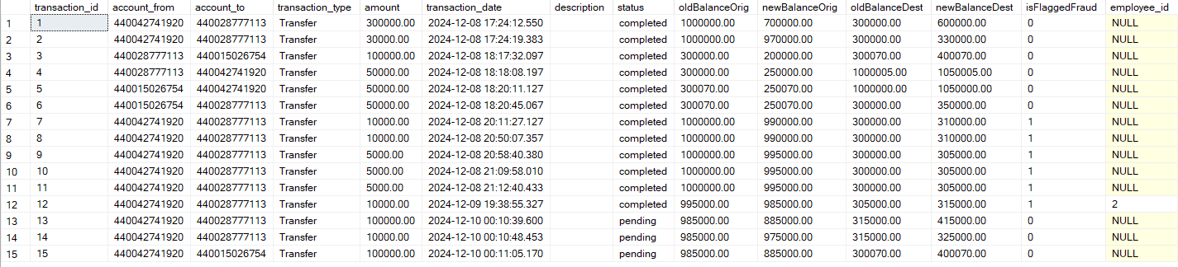
Machine learning implementation
One of the core features of the application is its Fraud Detection System, which leverages a machine learning model trained to identify fraudulent transactions. The process begins when a user initiates a money transfer to another user. The system collects necessary details, such as the transaction amount and recipient account information. Initially, the transaction enters a state marked as pending, meaning that it is queued for further processing. During this stage, the system does not yet move the money between accounts, as the transaction must undergo fraud detection to ensure its legitimacy. The transaction's status is stored in the database as 'pending' to signify that it has not been complete.

Slide 28
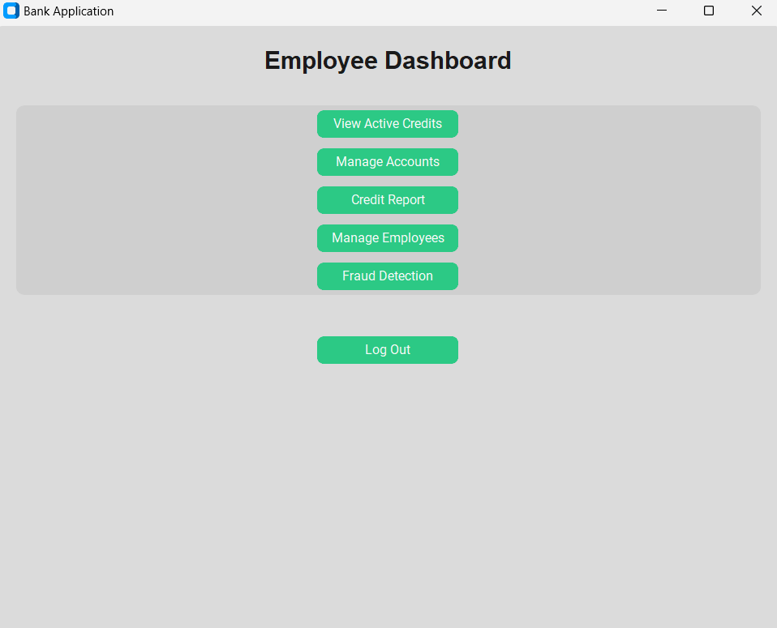
Fraud detection button
After the transaction is created and marked as pending, the next step involves an employee triggering the fraud detection process. When the fraud detection process is started, the system retrieves the relevant transaction data and uses a machine learning model to predict the likelihood of the transaction being fraudulent. The model evaluates various features of the transaction, such as the amounts involved and the account balances before and after the transaction.

Slide 29
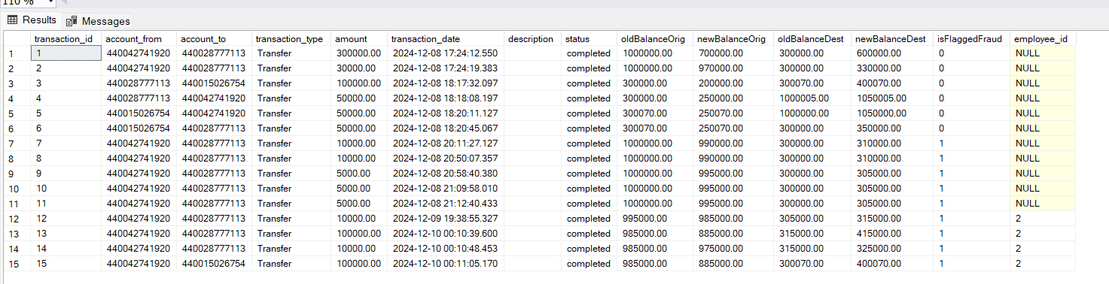
select * from transaction after fraud detection
If the model identifies the transaction as potentially fraudulent, the employee is notified, and the transaction can be flagged as fraudulent. If, however, the model indicates that the transaction is highly likely to be legitimate (with a fraud probability of less than 90%), the transaction is marked as completed. At this point, the status of the transaction is updated from 'pending' to 'completed’.

Slide 30

Conclusion
The detection of fraudulent activities in financial transactions is a critical area of focus in modern banking and finance. This project explored the application of machine learning algorithms to identify anomalous transactions and distinguish between legitimate and fraudulent activities. By analyzing transactional data and implementing predictive models, we have demonstrated the potential of machine learning to enhance security and minimize financial losses for institutions and customers alike. In conclusion, machine learning represents a transformative approach to combating financial fraud, offering significant improvements over traditional methods. However, its effectiveness depends on a combination of technological innovation, ethical considerations, and ongoing vigilance. By leveraging these tools responsibly, financial institutions can build a safer and more resilient financial ecosystem.

Slide 31

Thanks for attention

